Slide 1
Process and Thread

Slide 2
Contents
Program and Process
Thread and Process
Nachos Thread and Scheduler
Nachos Kernel Structure

Slide 3
Program and Process
After a program is compiled and linked, its binary executable is stored in a file.
What does this file look like? What is its format?
It must contain the following sections:
text: the binary code of the program to be executed
initialized data: global variables with initial data
the size of the uninitialized data: all un-initialized global variables are assumed to have value 0 and therefore, there is no need to store them in the binary executable.
Common Format of Executables
COFF: common format for executable in UNIX
NOFF: slightly different, used in Nachos
Notes:
".bss" stands for "block starting symbol". After all, the only thing you can do in defining uninitialized data is to give a name to the beginning of a block of data.

Slide 4
Program and Process
Let us have a look at NOFF
#define NOFFMAGIC 0xbadfad /* magic number denoting Nachos */
/ * object code file */
typedef struct segment {
int virtualAddr; /* location of segment in virtual addr space */
int inFileAddr; /* location of segment in this file */
int size; /* size of segment */
} Segment;
typedef struct noffHeader {
int noffMagic; /* should be NOFFMAGIC */
Segment code; /* executable code segment */
Segment initData; /* initialized data segment */
Segment uninitData; /* uninitialized data segment --*/
/* should be zero'ed before use */
} NoffHeader;

Slide 5
Program and Process
To run a program, the computer needs to load the executable into memory.
The memory required to run the program is called the address space.
Address space contains the following sections:
Text: the binary code of the program loaded from the executable file
initialized data: data area with initialized data copied from the executable file
bss : uninitialized data with zeros
stack: stack area for procedure calls
heap : area for dynamically allocated variables

Slide 6
Program and Process
A process is a program in execution.
Therefore, a process should be characterized by
address space (text, data, stack and heap)
program counter (PC): register for the address of next instruction
stack pointer (SP): register for the address of the top of stack
frame pointer (FP): register for the address of current stack frame
Other registers (user and system registers)
I/O resources (open files, open network sockets, etc)

Slide 7
Program and Process
Process Control Block (PCB): data structure to store all information to resume the process
process state
program counter (PC)
current stack pointer (SP) and frame pointer (FP)
other registers
address space
open I/O resources

Slide 8
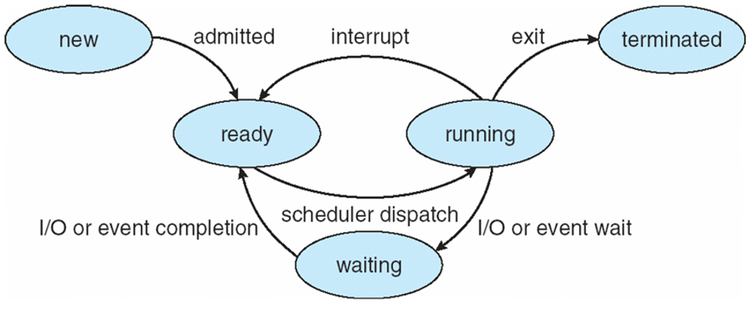
Program and Process
Process State
Each process can be in one of the five states
new
ready
running
waiting
terminated

Slide 9
Program and Process
State Transitions and their causes
nothing to new: process creation
new to ready: dispatch by job scheduler
ready to run: dispatch by the CPU scheduler
run to ready: time-out interrupt or others reasons
run to waiting(blocked): requests for services of the operating system which take time to complete
blocked to ready: completions of requested services

Slide 10
Program and Process
Where do the ready or wait processes stay?
Address spaces stay in memory, but PCB information stays in queues.
ready queue: store the PCB of the ready processes
wait queues: store the PCB of the waiting processes

Slide 11
Program and Process
A context switch from process P1 to process P2 is required, when
P1 is changed from running to blocked or ready and
P2 is changed from ready to running
The context switch from P1 to P2 involves:
save the context of P1 in its PCB and put it in an appropriate queue
load the context of P2 from its PCB
resume the execution of P2 from the address where it was stopped

Slide 12
Contents
Program and Process
Thread and Process
Nachos Thread and Scheduler
Nachos Kernel Structure

Slide 13
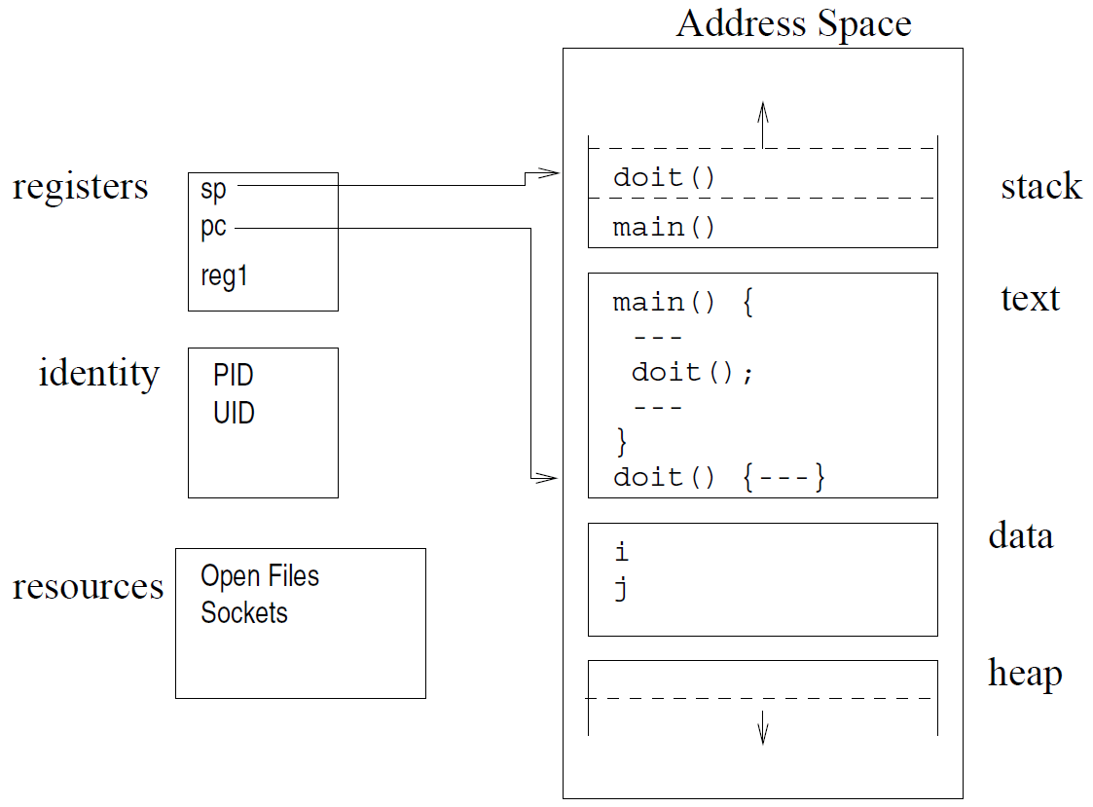
Thread and Process
Process is
a unit of dispatching for execution (PC, SP, and stack)
a unit of resource ownership (address space, open files, etc)
Components of a program in execution

Slide 14
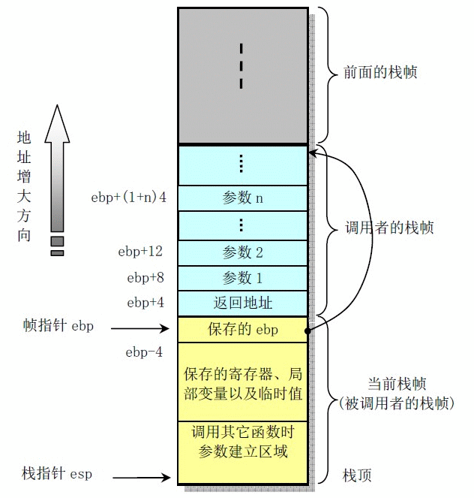
X86-32栈帧结构
栈底
栈生长方向

Slide 15
Thread and Process
However, a process does not have to have only a single unit of dispatching.
A thread is an execution stream within a process. (dispatching unit)
A process can have multiple threads
each has its own stack and control block (including thread state, id, etc)
but all share the common resources of the process

Slide 16
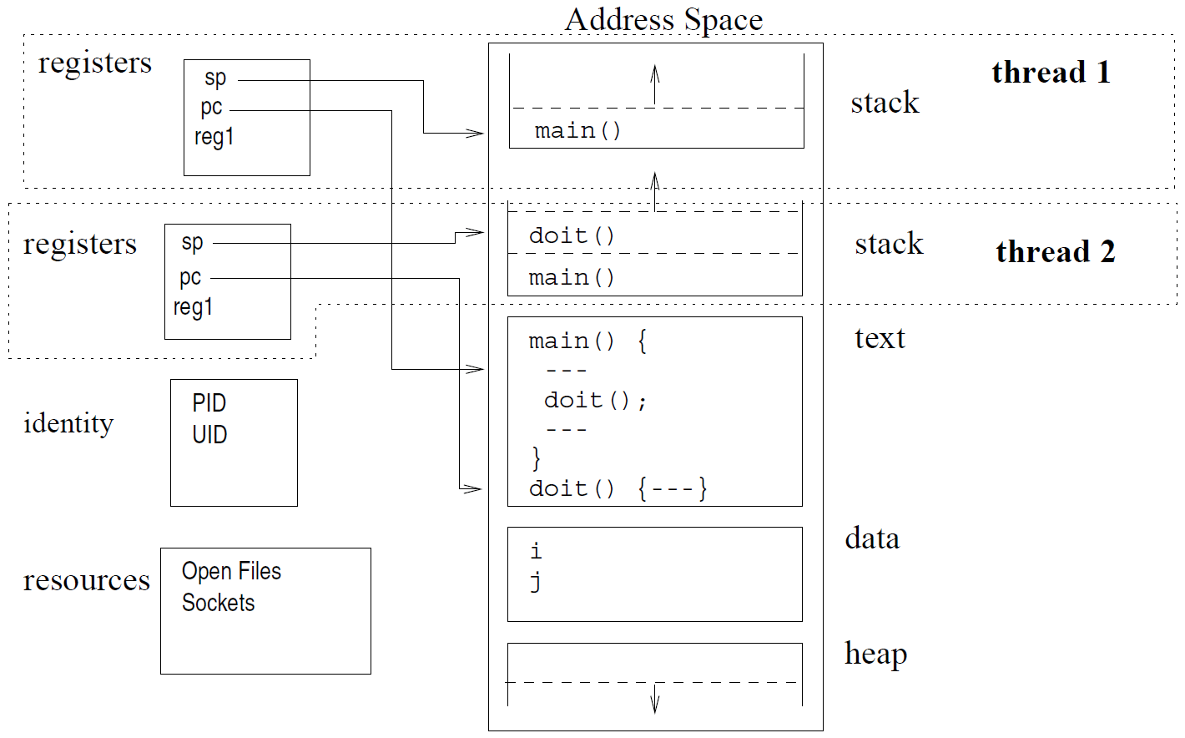
Thread and Process
Threads of a process

Slide 17
Thread and Process
Why threads?
It takes less time to
create and terminate a thread than a process
do context switch between threads than processes
Threads enable efficient communication because they share:
the address space
the resources owned by the process

Slide 18
Contents
Program and Process
Thread and Process
Nachos Thread and Scheduler
Nachos Kernel Structure

Slide 19
Nachos Thread and Scheduler
Development of Nachos
At development and debugging phase, Nachos is running as a process in UNIX/Linux.
On the raw machine, Nachos is running as the kernel of a real operating system. Nachos threads share the address space of the kernel.

Slide 20
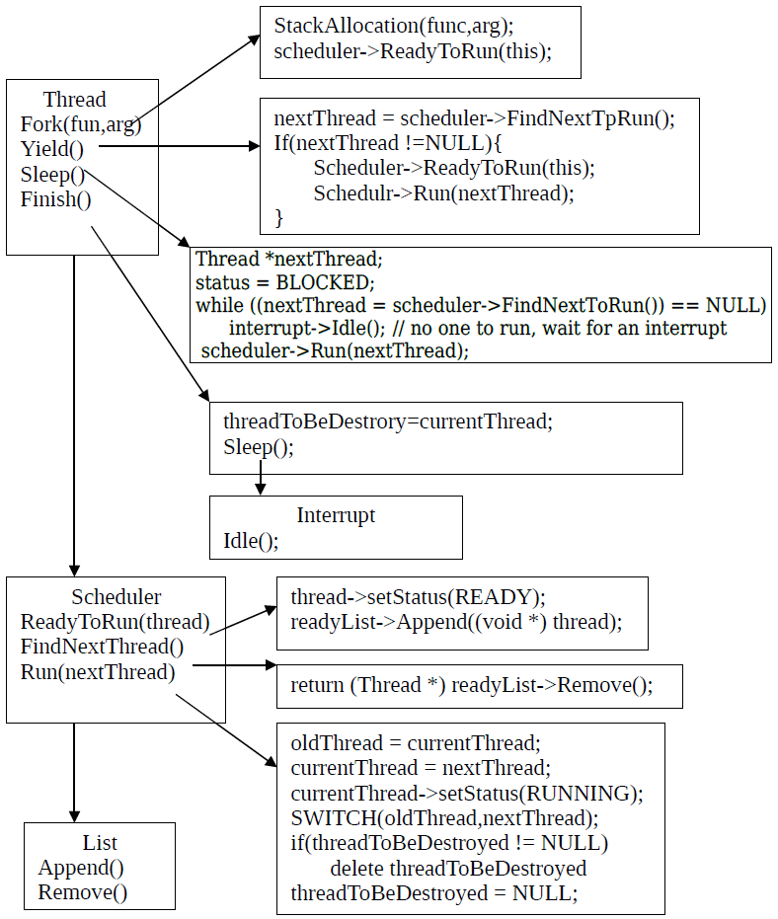
Nachos Thread and Scheduler
Nachos 线程实现框架图

Slide 21
Nachos Thread and Scheduler
Queues for Nachos Scheduler
files:
../threads/list.h
../threads/list.cc
classes
class ListElement {
public:
ListElement(void *itemPtr, int sortKey);
ListElement *next; // next element on list,
// NULL if this is the last
int key; // priority, for a sorted list
void *item; // pointer to item on the list
};

Slide 22
Nachos Thread and Scheduler
class List {
public:
List(); // initialize the list
~List(); // de-allocate the list
void Prepend(void *item); // Put item at the beginning of the list
void Append(void *item); // Put item at the end of the list
void *Remove(); // Take item off the front of the list
void Mapcar(VoidFunctionPtr func); // Apply "func" to every element
// on the list
bool IsEmpty(); // is the list empty?
// Routines to put/get items on/off list in order (sorted by key)
void SortedInsert(void *item, int sortKey); // Put item into list
void *SortedRemove(int *keyPtr); // Remove first item from list
private:
ListElement *first; // Head of the list, NULL if list is empty
ListElement *last; // Last element of list
};

Slide 23
Nachos Thread and Scheduler
Nachos Scheduler: A simple FIFO CPU scheduler
Files
../threads/scheduler.h
../threads/scheduler.cc
When Nachos is started, an object of class Scheduler is created and referenced by a global variable scheduler
Contains a queue and various scheduling functions

Slide 24
Nachos Thread and Scheduler
class Scheduler {
public:
Scheduler(); // Initialize list of ready threads
~Scheduler(); // De-allocate ready list
void ReadyToRun(Thread* thread); // Thread can be dispatched.
Thread* FindNextToRun(); // Dequeue first thread on the ready
// list, if any, and return thread.
void Run(Thread* nextThread); // Cause nextThread to start running
void Print(); // Print contents of ready list
private:
List *readyList; // queue of threads that are ready to run,
// but not running
};

Slide 25
Nachos Thread and Scheduler
The ready queue to hold all the threads in the READY state
List *readyList;
Put this thread at the end of ready queue:
void Scheduler::ReadyToRun (Thread *thread) {
DEBUG('t', "Putting thread %s on ready list.\n", thread->getName());
thread->setStatus(READY);
readyList->Append((void *)thread);
}
Select the thread to be dispatched:
Thread * Scheduler::FindNextToRun () {
return (Thread *)readyList->Remove();
}

Slide 26
Nachos Thread and Scheduler
Dispatch Function: calls SWITCH(..) to do the context switch
void Scheduler::Run (Thread *nextThread)
{
Thread *oldThread = currentThread;
#ifdef USER_PROGRAM // ignore until running user programs
if (currentThread->space != NULL) { // if this thread is a user program,
currentThread->SaveUserState(); // save the user's CPU registers
currentThread->space->SaveState();
}
#endif
oldThread->CheckOverflow(); // check if the old thread had an
// undetected stack overflow
currentThread = nextThread; // switch to the next thread
currentThread->setStatus(RUNNING); // nextThread is now running
DEBUG('t', "Switching from thread \"%s\" to thread \"%s\"\n",
oldThread->getName(), nextThread->getName());

Slide 27
Nachos Thread and Scheduler
SWITCH(oldThread, nextThread);
DEBUG('t', "Now in thread \"%s\"\n", currentThread->getName());
if (threadToBeDestroyed != NULL) {
delete threadToBeDestroyed;
threadToBeDestroyed = NULL;
}
#ifdef USER_PROGRAM
if (currentThread->space != NULL) { // if there is an address space
currentThread->RestoreUserState(); // to restore, do it.
currentThread->space->RestoreState();
}
#endif
}
Notes:
第一堂课到此结束

Slide 28
SWITCH(i386)(1)
/* void SWITCH( thread *t1, thread *t2 )
**
** on entry, stack looks like this:
** 8(esp) -> thread *t2
** 4(esp) -> thread *t1
** (esp) -> return address
**
**
**
**
*/
.comm _eax_save,4
Notes:
.comm name, size,alignment
The .comm directive allocates storage in the data section. The storage is referenced by the identifier name. Size is measured in bytes and must be a positive integer. Name cannot be predefined. Alignment is optional. If alignment is specified, the address of name is aligned to a multiple of alignment

Slide 29
SWITCH(i386)(2)
.globl SWITCH
SWITCH:
movl %eax,_eax_save # save the value of eax
movl 4(%esp),%eax # move pointer to t1 into eax
movl %ebx,_EBX(%eax) # save registers
movl %ecx,_ECX(%eax)
movl %edx,_EDX(%eax)
movl %esi,_ESI(%eax)
movl %edi,_EDI(%eax)
movl %ebp,_EBP(%eax)
movl %esp,_ESP(%eax) # save stack pointer
movl _eax_save,%ebx # get the saved value of eax
movl %ebx,_EAX(%eax) # store it
movl 0(%esp),%ebx # get return address from stack into ebx
movl %ebx,_PC(%eax) # save it into the pc storage

Slide 30
SWITCH(i386)(3)
movl 8(%esp),%eax # move pointer to t2 into eax
movl _EAX(%eax),%ebx # get new value for eax into ebx
movl %ebx,_eax_save # save it
movl _EBX(%eax),%ebx # retore old registers
movl _ECX(%eax),%ecx
movl _EDX(%eax),%edx
movl _ESI(%eax),%esi
movl _EDI(%eax),%edi
movl _EBP(%eax),%ebp
movl _ESP(%eax),%esp # restore stack pointer
movl _PC(%eax),%eax # restore return address into eax
movl %eax,0(%esp)
movl _eax_save,%eax
ret

Slide 31
Nachos Thread Overview
Nachos Thread and its Control block
The thread control block of Nachos thread is implemented as the data member of Thread class.
class Thread {
private:
int* stackTop; // the current stack pointer
_int machineState[MachineStateSize]; // all registers except for stackTop
...
private:
// some of the private data for this class is listed above
int* stack; // Bottom of the stack
// NULL if this is the main thread
// (If NULL, don't deallocate stack)
ThreadStatus status; // ready, running or blocked
char* name;
...
};

Slide 32
Nachos Thread Overview
class Thread {
private:
int* stackTop; // the current stack pointer
_int machineState[MachineStateSize]; // all registers except for stackTop
public:
...
private:
...
#ifdef USER_PROGRAM
int userRegisters[NumTotalRegs]; // user-level CPU register state
public:
void SaveUserState(); // save user-level register state
void RestoreUserState(); // restore user-level register state
AddrSpace *space; // User code this thread is running.
#endif
};
Nachos Process= Nachos Thread + Address Space + User Registers

Slide 33
Nachos Thread Operations
The thread operations such as creation and blocking are implemented as methods of Thread class.
class Thread {
...
public:
...
// basic thread operations
void Fork(VoidFunctionPtr func, _int arg); // Make thread run (*func)(arg)
void Yield(); // Relinquish the CPU if any
// other thread is runnable
void Sleep(); // Put the thread to sleep and
// relinquish the processor
void Finish(); // The thread is done executing
void CheckOverflow(); // Check if thread has
// overflowed its stack
void setStatus(ThreadStatus st) { status = st; }
char* getName() { return (name); }
void Print() { printf("%s, ", name); }
...

Slide 34
Nachos Thread Creation
Creation: Thread(char* debugName)
implements the transition from “nothing" to “new"
initializes all the private data members but machineState
Thread::Thread(char* threadName) {
name = threadName;
stackTop = NULL;
stack = NULL;
status = JUST_CREATED;
#ifdef USER_PROGRAM
space = NULL;
#endif
}
The thread created is not ready to run yet.

Slide 35
Nachos Thread Fork
Long-term scheduler dispatch:
void Fork(VoidFunctionPtr func, int arg)
Implements the transition from " new" to " ready"
Allocates the stack for the thread
Set register states in machineState[] including the addresses of
subroutines for initialization and clean-up
subroutine to be executed for the life time of the thread and the argument (one) of the subroutine to be executed.

Slide 36
Nachos Thread Fork
void Thread::Fork(VoidFunctionPtr func, _int arg)
{
...
StackAllocate(func, arg);
IntStatus oldLevel = interrupt->SetLevel(IntOff);
scheduler->ReadyToRun(this); // ReadyToRun assumes that interrupts
// are disabled!
(void) interrupt->SetLevel(oldLevel);
}

Slide 37
Nachos Stack Allocate
Private function which does the job for Fork(..): StackAllocate
allocates a stack and initializes machineState[]
void Thread::StackAllocate (VoidFunctionPtr func, _int arg)
{
stack = (int *) AllocBoundedArray(StackSize * sizeof(int));
stackTop = stack + StackSize - 4; // -4 to be on the safe side!
machineState[PCState] = (_int) ThreadRoot;
machineState[StartupPCState] = (_int) InterruptEnable;
machineState[InitialPCState] = (_int) func;
machineState[InitialArgState] = arg;
machineState[WhenDonePCState] = (_int) ThreadFinish;
}

Slide 38
ThreadRoot(i386)
.globl ThreadRoot
/* void ThreadRoot( void )
** expects the following registers to be initialized:
** eax points to startup function (interrupt enable)
** edx contains inital argument to thread function
** esi points to thread function
** edi point to Thread::Finish() */
ThreadRoot:
pushl %ebp
movl %esp,%ebp
pushl InitialArg
call *StartupPC
call *InitialPC
call *WhenDonePC
# NOT REACHED
movl %ebp,%esp
popl %ebp
ret
Notes:
除了默认的线程main外，其他线程都从ThreadRoot开始执行，这可从前页StackAllocate函数中的语句 machineState[PCState] = (_int) ThreadRoot;
看出

Slide 39
Nachos Thread Yield
Time-out: void Yield()
implements the transition from " running" to " ready"
voluntarily relinquishes CPU if there is another ready thread to run
call scheduler->Run(nextThread) for context switch if needed
void Thread::Yield () {
Thread *nextThread;
IntStatus oldLevel = interrupt->SetLevel(IntOff);
ASSERT(this == currentThread);
DEBUG('t', "Yielding thread \"%s\"\n", getName());
nextThread = scheduler->FindNextToRun();
if (nextThread != NULL) {
scheduler->ReadyToRun(this);
scheduler->Run(nextThread);
}
(void) interrupt->SetLevel(oldLevel);
}

Slide 40
Nachos Thread Sleep
Block (or wait): void Sleep()
implements the transition from " running" to " blocked"
void Thread::Sleep () {
Thread *nextThread;
ASSERT(this == currentThread);
ASSERT(interrupt->getLevel() == IntOff);
DEBUG('t', "Sleeping thread \"%s\"\n", getName());
status = BLOCKED;
while ((nextThread = scheduler->FindNextToRun()) == NULL)
interrupt->Idle(); // no one to run, wait for an interrupt
scheduler->Run(nextThread); // returns when we've been signaled
}
Before calling this function, the thread usually puts itself into the queue associate with the corresponding I/O device or event
Notes:
见课本19页解释

Slide 41
Nachos Thread Finish
Termination: void Finish()
partially implements the transition from “running" to “terminated"
sets global variable threadToBeDestroyed to point to this thread
calls Sleep() to dispatch new thread
void Thread::Finish () {
(void) interrupt->SetLevel(IntOff);
ASSERT(this == currentThread);
DEBUG('t', "Finishing thread \"%s\"\n", getName());
threadToBeDestroyed = currentThread;
Sleep(); // invokes SWITCH
// not reached
}

Slide 42
Nachos Thread Finish
It is called by ThreadFinish, the clean-up function called by ThreadRoot, when the thread is done with executing the “real“ job.
static void ThreadFinish() { currentThread->Finish(); }
But, the current thread invoking Finish() cannot delete itself.(Can you do delete this in C++?)
This task of deleting is done by the next running thread after the context switch.
...
SWITCH(oldThread, nextThread);
DEBUG('t', "Now in thread \"%s\"\n", currentThread->getName());
if (threadToBeDestroyed != NULL) {
delete threadToBeDestroyed;
threadToBeDestroyed = NULL;
}
...

Slide 43
Contents
Program and Process
Thread and Process
Nachos Thread and Scheduler
Nachos Kernel Structure

Slide 44
Nachos Kernel Structure
Structure of Nachos Kernel-minimum set of components
a CPU scheduler
an interrupt simulator
a timer simulator
a module for statistics
at least one Nachos kernel thread
Nachos kernel starts with ../threads/main.cc

Slide 45
Nachos Kernel Structure
Nachos Kernel bootstrap
create the Nachos components as above
run function Initialize(argc, argv) in system.cc
...
#include "utility.h"
#include "system.h"
...
int main(int argc, char **argv) {
int argCount; // the number of arguments
// for a particular command
DEBUG('t', "Entering main");
(void) Initialize(argc, argv);
...
}

Slide 46
Nachos Kernel Structure
Global variables for the Kernel Components
global variable definitions in ../threads/system.cc
...
#include "system.h"
// This defines *all* of the global data structures used by Nachos.
// These are all initialized and de-allocated by this file.
Thread *currentThread; // the thread we are running now
Thread *threadToBeDestroyed; // the thread that just finished
Scheduler *scheduler; // the ready list
Interrupt *interrupt; // interrupt status
Statistics *stats; // performance metrics
Timer *timer; // the hardware timer device,
...

Slide 47
Nachos Kernel Structure
exported through ../threads/system.h
#include "copyright.h"
#include "utility.h"
#include "thread.h"
#include "scheduler.h"
#include "interrupt.h"
#include "stats.h"
#include "timer.h"
// Initialization and cleanup routines
extern void Initialize(int argc, char **argv); // Initialization,
// called before anything else
extern void Cleanup(); // Cleanup, called when
// Nachos is done.
extern Thread *currentThread; // the thread holding the CPU
extern Thread *threadToBeDestroyed; // the thread that just finished
extern Scheduler *scheduler; // the ready list
extern Interrupt *interrupt; // interrupt status
extern Statistics *stats; // performance metrics
extern Timer *timer; // the hardware alarm clock
...

Slide 48
Nachos Kernel Structure
Initialize(argc, argv) in ../threads/system.cc
Process arguments and set up variables and flags
Construct the kernel components including the TCB(thread control block ) for the first running thread

Slide 49
Nachos Kernel Structure
...
DebugInit(debugArgs); // initialize DEBUG messages
stats = new Statistics(); // collect statistics
interrupt = new Interrupt; // start up interrupt handling
scheduler = new Scheduler(); // initialize the ready queue
if (randomYield) // start the timer (if needed)
timer = new Timer(TimerInterruptHandler, 0, randomYield);
threadToBeDestroyed = NULL;
// We didn't explicitly allocate the current thread we are running in.
// But if it ever tries to give up the CPU, we better have a Thread
// object to save its state.
currentThread = new Thread("main");
currentThread->setStatus(RUNNING);
interrupt->Enable();
CallOnUserAbort(Cleanup); // if user hits ctl-C
...

Slide 50
Nachos Kernel Structure
What is the current running thread before the kernel creates any new thread?
It is the thread started by main() of the kernel.
It is born as the first " running" thread.
It is not started with Fork(func, arg).
It does not follow the three stages defined by ThreadRoot.
It does need a thread control block for context switch.
It terminates itself by calling Finish() directly.

Slide 51
Nachos Kernel Structure
What does the first kernel thread do after initialization?
It can create new kernel threads for various purposes such as
daemon threads for networking, file systems, etc
threads to get user processes started
It can terminate itself after the other system threads are created and the kernel continues with those threads created.
At moment, it starts a test program before termination.
...
DEBUG('t', "Entering main");
(void) Initialize(argc, argv);
#ifdef THREADS
ThreadTest();
#if 0
SynchTest();
#endif
#endif
...

Slide 52
Nachos Kernel Structure
Our first Nachos Test function from ../threads/threadtest.cc
Test function ThreadTest() called by the first kernel thread
void ThreadTest() {
DEBUG('t', "Entering SimpleTest");
Thread *t = new Thread("forked thread");
t->Fork(SimpleThread, 1);
SimpleThread(0);
}
What is SimpleThread(...)?
void SimpleThread(_int which) {
int num;
for (num = 0; num < 5; num++) {
printf("*** thread %d looped %d times\n", (int) which, num);
currentThread->Yield();
}
}

Slide 53
Nachos Kernel Structure
What is happening?
A new threads running function SimpleThread(1) is created.
The kernel thread calls function SimpleThread(0).
Two threads time-out repeatedly and print messages alternatively
Many context switches are performed. (How many?)
The kernel thread calls Finish() after ThreadTest()
...
currentThread->Finish(); // NOTE: if the procedure "main“ returns, then the
// program "nachos“ will exit (as any other normal program would).
// But there may be other threads on the ready list.
// We switch to those threads by saying that the
// "main" thread is finished, preventing it from returning.
return(0); // Not reached...
}

Slide 54
Nachos的启动过程
参见源代码文件：main.cc
参见源代码文件 system.cc 中的函数 void Initialize(int argc, char **argv)

Slide 55
Thanks!

